Slide 1

National University of Computer and Emerging Sciences
Vision Transformers
Deep Learning

Slide 2
Goals
Review of Previous Lecture
Today’s Lecture
Vision Transformers (ViT)

Slide 3
Recap of Previous Lecture

Slide 4
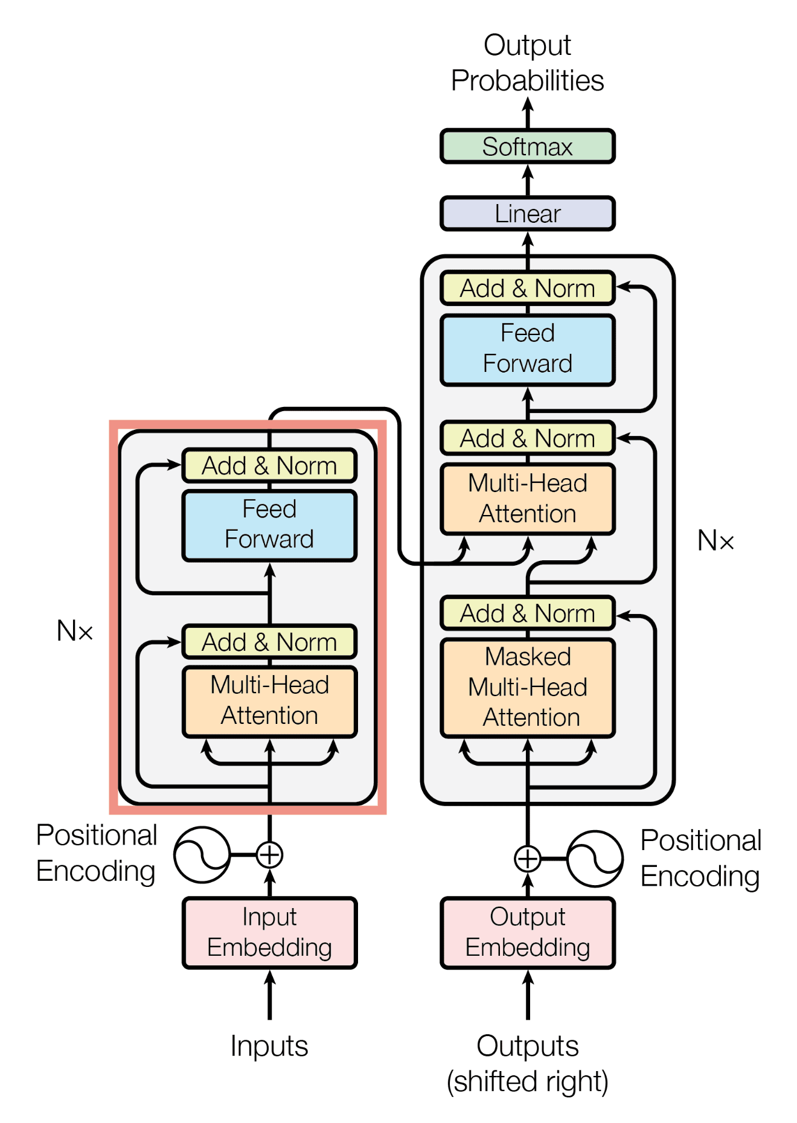
Transformer Model Architecture
The Transformer contains the following component:
Encoder
Decoder
Consists of
Stacked self-attention
Fully connected layers

Slide 5
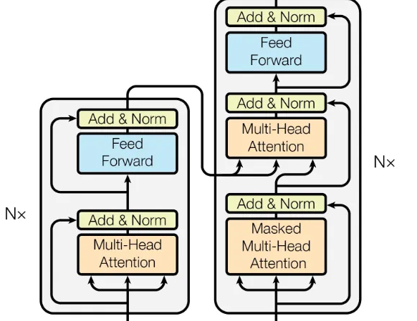
Self-Attention & Cross-Attention
Self- and cross-attention only differ in which tokens are given as inputs Q, K, and V.
In self-attention, the same tokens are used for all three inputs
In cross-attention, the same tokens are given to K and V, but different tokens are used for Q.

Slide 6
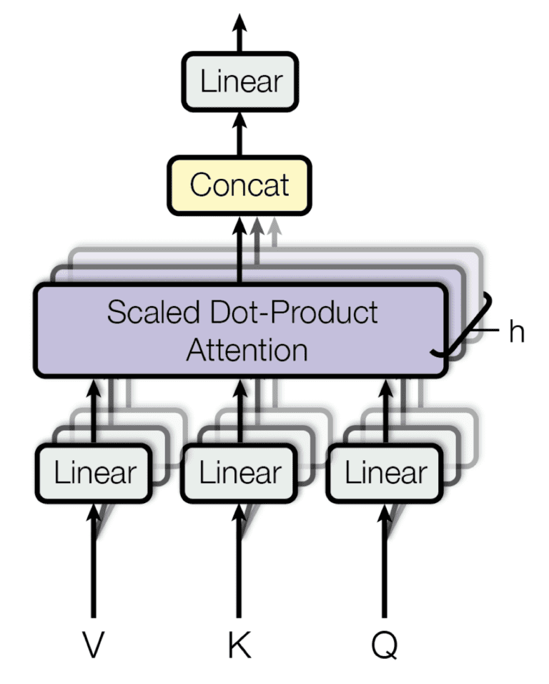
Multi-Head Attention

Slide 7
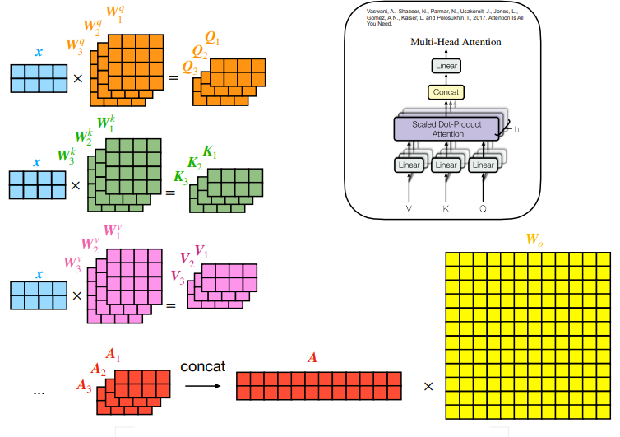
Multi-Head Attention
medium.com

Slide 8
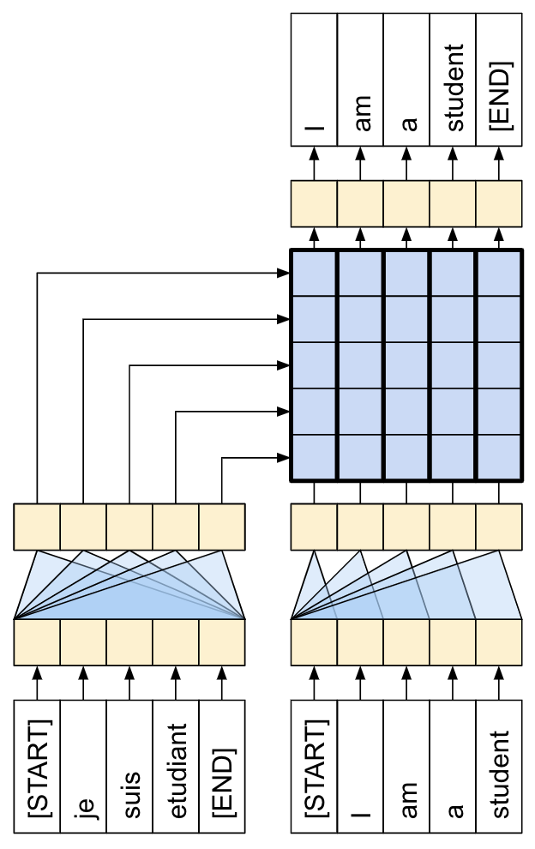
Training Transformers

Slide 9
Multi-Head Attention
Example:
Consider queries (Q), keys (K), and values (V) with dimensions 10 x 6
Model Dimensionality: 6 (embedding size)
Number of Heads: 3 (for this example)
Projection Dimension: d_{k}​=d_{v​}=2
Weight matrices: W_{Q},W_{K},W_{V} : need 3 set one for each head, its size is 6x2.

Slide 10
Transformer Implementation
The Transformer consists of the following key components:
Input Embedding: Convert input tokens to dense vector representations.
Positional Encoding: Adds information about the order of tokens.
Scaled Dot-Product Attention: Computes attention scores between tokens.
Multi-Head Attention: Uses multiple attention heads for better representation learning.
Feedforward Network (FFN): Applies a two-layer MLP with ReLU activation.
Layer Normalization: Normalizes input for stable training.
Residual Connections: Helps in gradient flow and stability.
Encoder: Stacks multi-head attention and FFN layers.
Decoder: Similar to the encoder but with an additional cross-attention layer.
Final Linear & Softmax Layer: Converts the decoder output into probabilities.

Slide 11
Solved Numerical Example

Slide 12
Today’s Lecture

Slide 13
AN IMAGE IS WORTH 16X16 WORDS: TRANSFORMERS FOR IMAGE RECOGNITION AT SCALE Vision Transformer (ViT)

Slide 14
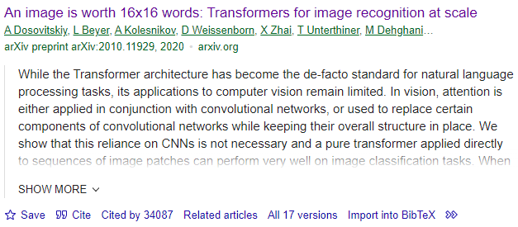

Vision Transformer (ViT)

Slide 15
Vision Transformer (ViT)
Transformer architecture has become the de-facto standard for natural language processing tasks
Its applications to computer vision remain limited.
In vision, attention is either applied in conjunction with convolutional networks
A pure transformer applied directly to sequences of image patches can perform very well on image classification tasks.
Vision Transformer (ViT) attains excellent results compared to state-of-the-art convolutional networks while requiring substantially fewer computational resources to train

Slide 16
Vision Transformer (ViT)
New way for applying a standard Transformer directly to images
Split an image into patches
Image patches are treated the same way as tokens (words) in an NLP application.
Patch Embeddings.
The ViT uses only the Encoder Part of Transformer
The Transformer uses constant latent vector size D through all of its layers, so we flatten the patches and map to D dimensions with a trainable linear projection

Slide 17
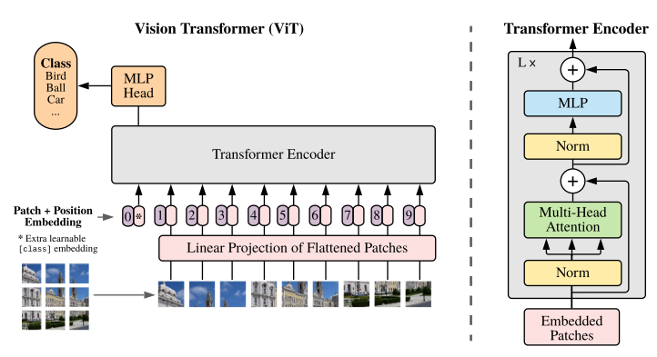
Vision Transformer (ViT)

Slide 18
Working: ViT
Split an image into patches:
The first step in processing an image with a Vision Transformer is to divide it into smaller, fixed-size patches.
sequence of linear embeddings of these patches as an input to a Transformer
Each patch represents a local region of the image.
Flatten the patches:
Pixel values are flattened into a single vector.
Treat image patches as sequential data.

Slide 19
Working: ViT
Produce lower-dimensional linear embeddings:
Pass these flattened patches via Linear Layer to transform into a lower-dimensional space.
Reduces the dimensionality of the data while preserving important features.
Generate positional encodings:
Positional encodings are generated and added to include the relative positions of different patches in the image.

Slide 20
Working: ViT
Transformer Encoder:
The input to a standard Transformer encoder comprises the sequence of patch embeddings and positional embeddings.
Layer normalization (LN) is applied to scale the data within the layer, ensuring stability and efficiency during training.
This encoder is composed of two main components:
Multi-head self-attention
Multi-layer perceptron (MLP) blocks.

Slide 21
Working: ViT
Gaussian Error Linear Unit (GELU)
An approximation to GELU is performed using
Classification Token:
The classification head is implemented by a MLP with one hidden layer
To enable image classification, a special "classification token" is prepended to the sequence of patch embeddings.
This token's state at the output of the Transformer encoder serves as the representation of the entire image.

Slide 22
Reading Task
Read the Vision Transformer Paper in Details:
Download Paper
Specifically look at these questions.
Why Vision Transformer has much less image-specific inductive bias than CNNs?
How the Hybrid Architecture is tested in ViT paper?
How Fine-Tuning is performed?
Explain what is self-supervised pre-training?
What challenges are highlighted by ViT paper?

Slide 23
Thank You ☺

